Slide 1
American Psychological Association
21st Century Edition
2013
Andrew Ferneyhough
Comox, Canada

Slide 2
Running Head: MY PHILOSOPHY OF ONLINE FACILITATION/LEARNING 1
Modified
My Philosophy of Online Communication
and How it Relates to Online Learning
Andrew Ferneyhough
OLTD 503
Vancouver Island University
Modified

Slide 3
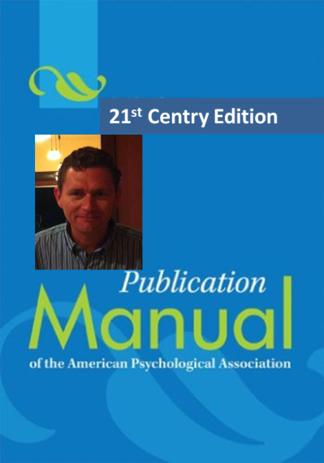
Introduction
As we were given the choice of presenting our final paper in OLTD 503 in the form of an APA style paper or a style of our choice, I thought I might be best served by delivering in a style that combined both options. With that in mind I have created, and applied, the 21st edition of the American Psychological Associations’ official writing guide. I believe it is a good mix of the old and the new. It keeps with tradition while adding a sense of personality and innovation.
“I really liked the honesty that informed your paper.”
Kim Lemieux
Throughout this essay I will quote and paraphrase from my original essay entitled, “My Philosophy of Online Communication and How it Relates to Online Learning” (Ferneyhough, 2013). I will also refer to several articles referred to me by peers throughout our six week course as well as comments made by these same peers. I learned much throughout this course, not only through the readings, but primarily through my discourse with my fellow students as well as my experience in facilitating my section of the course. I will stick with the previous entitled sections of beliefs; identity and mission as they provide simple yet powerful distinctions on which to base my new found learnings.

Slide 4
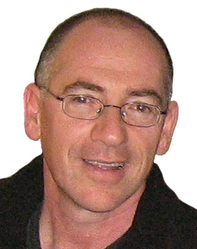
My Beliefs
In my original paper I improperly referenced a fellow teacher and his views on ‘context’. I think it is important to come back to that instance when I first heard fellow teacher, and friend, Avi Luxenburg speak about the relevance of placing learning within a contextual environment as it has shaped, and continues to shape, many of the decisions I make when it comes to my lesson planning (Luxenburg).
He spoke of a student who was trying to solve a problem with the game programming with which he was engaged. In order to solve this problem he had to gain a better understanding of the Cartesian Coordinate Grid. This student needed this piece of mathematical information in order to get further along in his journey. Few things in my career have had such an impact as did this revelation and concept of learning. One of the many reasons that I am in this program is to continue my pursuit of that Holy Grail of learning opportunities: the ability to make learning a necessity; a desire; a passion.
Avi Luxenburg (aluxenburg) on Twittertwitter.com - 277 × 351

Slide 5
My My Beliefs cont’d
Looking back over the last few weeks I can honestly say that I have had many small components of my belief system either changed or slightly altered. This is in part due to the conversations and candid opinions of my peers.
One such interaction came during our facebook exercise, in which Justin Mark and I posted videos and asked our cohort to respond however they felt appropriate. Several people had a look at the video on the industrialization of farming and made it very clear to me that this video was far too biased and possibly even offensive to some local family farmers. I had proposed it as a piece for which one might start a conversation on the importance of seeing both sides of an issue, however, to date I had not yet shared any counterarguments for this video with my classes. These honest and candid thoughts from my peers have made me rethink how I will deliver this unit and/or if I will show this piece at all.

Slide 6
My My Beliefs cont’d
A second valuable interaction came as a result of reading a peer’s response to our posted question, “What is your vision of the future?” As this person noted in a private email that they were not sure if they would even post their response due to the nature of its content, I have decided not to reference it here. The nature of this post was regarding the wording that the current government was using for its vision of the future. She found that phrases such as ‘21st Century Learning’, and ‘student centered learning’ were insulting to current and past teachers. She felt it implied that teachers past and present have not been working hard enough and that they needed this new guidance to create a better future. This set off some very interesting conversations over the next few days.

Slide 7
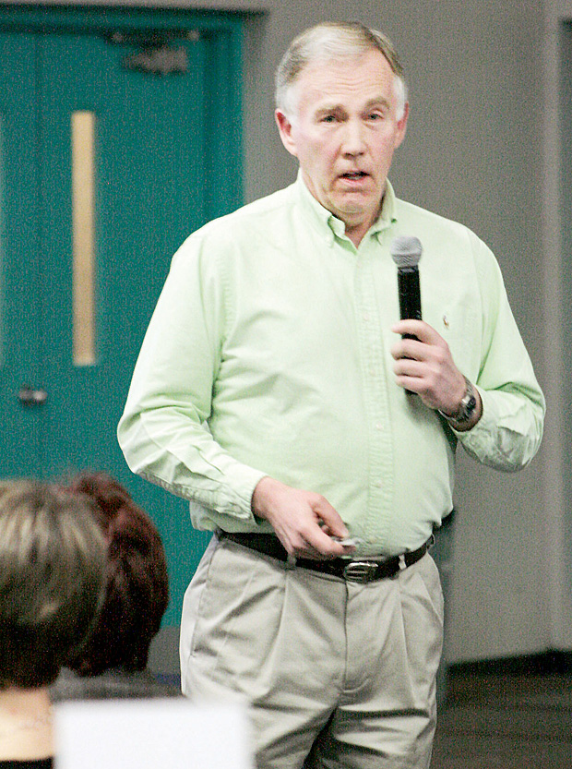
My My Beliefs cont’d
The same day, shortly after I read this post, I paid a visit to my Principal Bill Green at the local hospital where he was recovering from a burst appendix. When I broached this topic he was very adamant, or as adamant as you can be in a hospital bed hooked up to an IV, that this was not the case. He had recently been invited down to Victoria to speak with a couple of ‘Big Wigs’ in Education and had been extremely impressed with their ideas, their ideology, and their focus at putting paper into practice. Their offices were open areas with tables and stations at which various people might congregate to brainstorm and plan. He came away with the overall impression that the BC Ed. Plan was not just a document spit out for political reasons, but an idea that these people were taking seriously and committed to making an impression on education in BC.
The next day, I attended an evening session with Dr. Bruce Beairsto. Sure enough, the words and phrases that had been on my mind were on the first slide of Dr. Beairsto’s presentation. One of the things that he proceeded to explain in his presentation was that these words were not new. They were not invented by this government. He presented documents dating back to 1989 that illustrated a brief history of this jargon, some of which is actually mandated by legislation.
My belaboured point here is that had it not been for my peer posting their thoughts on this topic, I would have had nowhere near the level of interest and contextual involvement over the following few days. The process allowed me to become much more educated, and in some way altered my beliefs, in one sliver of our very complicated profession and for that I am grateful.
Face of education changingwww.langleyadvance.com

Slide 8
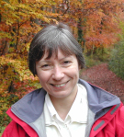
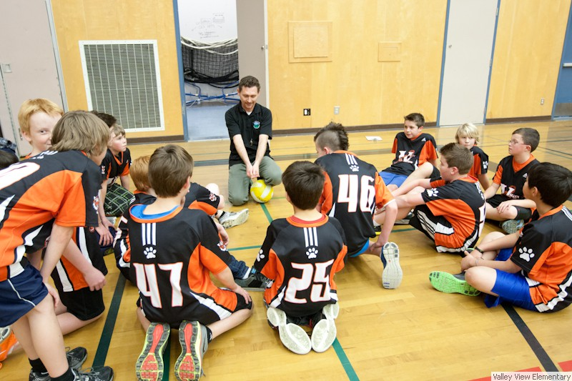
My My Identity
In my original paper I quoted Salmon Kahn stating that, “I just want to be having fun with my students.” (Khan, 2011). I stated that, “This concept, I believe, is what makes me a good teacher.” (Ferneyhough, 2013) This is, and hope continues to be for years to come, my main identity as a teacher. The trick here, in this course, has been to figure out how I will continue to grow in this area especially as it relates to online learning. Just because I ‘have fun’ with my students in a face to face environment, does not mean that I will be capable of replicating this ability in an online environment. I regret that my first paper was somewhat lacking in this area and would like to focus a bit more here on how events over the past few weeks may impact my abilities to create an enjoyable online experience in the future.
“provide learning experiences that fulfil students’ intellectual and social needs, and help develop a positive and open attitude for learning, and away from delivery of content.” (Kear, 2011)
About the Author | Online and Social Networking Communitiesonlinesocial.wordpress.com
In chapter 9 of Karen Kear’s book Online and Social Networking Communities, she focuses on the transition from face-to-face teaching to an online or blended context. She states that the role of the teacher will be to, “provide learning experiences that fulfil students’ intellectual and social needs, and help develop a positive and open attitude for learning, and away from delivery of content.” (Kear, 2011) I this section I would like to pinpoint some of the articles, activities, and conversations that I feel will help me in shaping my future online identity.
The PR Counselor Blog - Dan Keeney of DPK Public Relations on the ...danielkeeney.com
Me having fun.

Slide 9
My My Identity cont’d
To begin with I would like to talk about our experience using Facebook as a vehicle outside of our designated LMS. Early on in this course I had heard Justin remark that he used Facebook with one of his classes. When we decided to team up and began brainstorming on various ways of presenting our chapter it was I who brought up the idea of using Facebook, asking him if he would show me the ropes.
I had no idea if it would be successful or even how we would use it, but I am a firm believer in trying to use the technology that students are already engaged in to try and stimulate interest in learning.
In the end, we simply used it to load various videos that we felt were relevant to our topic and asked our peers to comment on these posts. I had no idea how much enjoyment I would get out of these quick little comments. Being able to make comments back to my peers while on the ferry or at my lunch break made it seem somehow exciting. I firmly believe that the casual nature of these comments versus an official post in a blog made these posts easier and less threatening than some other tasks.
This is certainly an atmosphere and concept that I would love to test and apply with classes of my own. I do not think that my current grade 6/7 class is the ideal testing ground, however, I will certainly be keeping a lookout for my next available opportunity for social networking in the classroom.

Slide 10
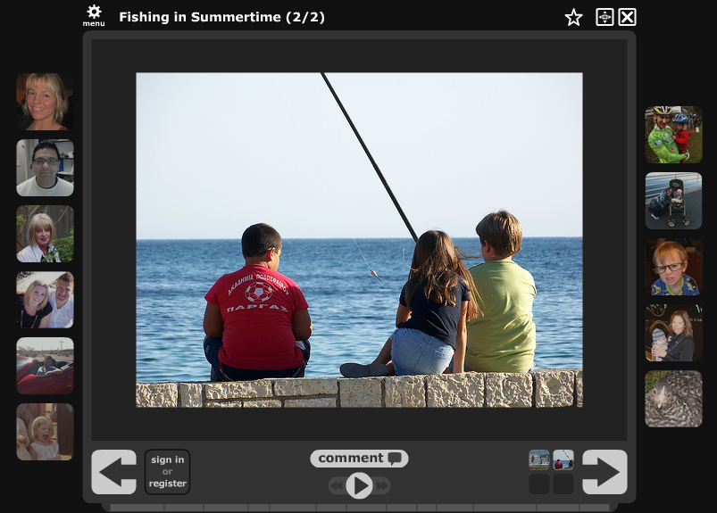
My My Identity cont’d
One of my favourite parts of their week was reading and responding to each other’s blogs. Yes, we were sharing details about our lives, but we were also discussing the intimacies of our classrooms. It was very comforting to hear Jean talk about the atmosphere in her classroom. When talking about her room she stated that, “there are times when it does look like chaos, but it is a controlled chaos where each group understands their parameters of behaviour and their responsibilities to the classroom learning environment.” (Blog, 2013) I do not work with many teachers whose environments are similar to mine. It is sometimes very comforting to compare notes with peers who are experiencing and cultivating similar relationships.
A second aspect that I would like to cover in relation to my future online identity is that of creating a strong sense of community among my learners. In week four Sonny and Jean provided us with several excellent examples of ways to foster community with an online audience.
The exercise of providing a picture and having us dictate our thoughts through voice thread has resonated with me since the exercise. It was thought provoking for me personally and in turn provided me with a greater sense and awareness of others in my cohort.
Even though Mary O’Neil had us do write-ups on ourselves at the beginning of the course, I partly wished we had done more of this type of sharing initially. Perhaps it was simply a lack of time or interest on my part in reading other’s posts. Whatever the reason I am glad that we had a chance to revisit a look at our personal lives.

Slide 11
My My Mission
In my original paper I stated that my mission was to, “continue to find lessons, units, programs and strategies that help me be who I am and reflect the ‘core values’ that I have set for myself.” (Ferneyhough, 2013) This is a perfectly valid goal, and certainly a part of the bigger puzzle, however, I think I need to step back a bit further and look at the big picture.
In OLTD 502 with Randy LaBonte, I created a document that outlined a plan that would have me playing a role in the future of ‘Blended Learning’ in SD71. I initiated a discussion with our Principal of Elementary Education Allen Douglas who is interested in forming a committee who’s primary focus would be to discuss and formulate a plan for alternative options to our traditional brick and mortar classrooms.
A second purpose of this document was to, “be a working document (possibly a website) that will allow me to gather information pertaining to an inquiry question..” (Ferneyhough, 2013). During the process of creating this document for OLTD 502 I came to the conclusion that my previous inquiry question involving the use of PDA’s in the classroom was simply not big enough. My goal now is bring this course and this program in line with my goals for the future of this district. I want to play a role in shaping the future education for students in the Comox Valley. That is a mission that I can sink my teeth into.

Slide 12
My Conclusion
In conclusion, I have enjoyed the structure of classifying my thoughts and learnings into the three categories of beliefs, identity, and mission. It has helped to simplify the mass of information and ideas in which we have immersed ourselves and each other. I am also thankful for the reminder that this was an exercise in analysing our beliefs as they relate to online learning. As beneficial as it is to analyse and critique our own practice it is important to remember why we are here in this course. Finally, as mentioned in my Mission section as well as my previous concluding statement, I am determined to aid my district, my school, as well as my own practice in blurring the lines between our traditional brick and mortar classrooms and a future blended model, in whatever form that may eventually take. I believe that this course has taken me a large step forward in attaining that goal.

Slide 13
My References
Ferneyhough, A. (2013). Final assignment oltd 502. Vancouver Island University, Nanaimo, Canada.
Ferneyhough, A. (2013). My philosophy of online communication and how it relates to online learning. Vancouver Island University, Nanaimo, Canada.
Kahn, S. (2011). Salman khan talk at ted 2011 (from ted.com) [Web]. Retrieved from https://www.khanacademy.org/talks-and-interviews/v/salman-khan-talk-at-ted-2011--from-ted-com
Kear, K. (2011). Online and Social Networking Communities: a Best Practice Guide for Educators. New York and London: Routledge.
Kloppenburg, J. (2013, Feb 06). [Web log message]. Retrieved from https://d2l.viu.ca/d2l/le/content/18838/viewContent/74498/View?ou=18838
Luxenburg, A. (Early 2000’s). Speaking to a group of Administrators and School Board Trustees. Lecture conducted from Kingfisher Resort, Courtenay.

